Slide 1


Being School Ready
A talk by the Inclusion Team for Potters Gate and St Andrews

Slide 2
What “School Ready” Really Means
When we talk about school readiness, we’re talking about a set of developmental foundations, not academic achievements. The most important areas are:
Emotional readiness — being able to separate from caregivers, express feelings, and begin to manage big emotions.
Social readiness — taking turns, sharing, joining in play, and beginning to resolve small disagreements.
Communication skills — expressing needs, listening to others, and understanding simple instructions.
Independence skills — toileting, dressing, eating, and looking after belongings.
Curiosity and willingness to learn — asking questions, exploring, and having the confidence to try.
These are the foundations that help children feel secure and ready to learn.

Slide 3
Emotional Readiness: The Heart of School Success
Children don’t need to be fearless — they just need to know that it’s okay to feel nervous, and that adults will support them.
Key emotional skills include:
Managing feelings — recognising when they feel sad, worried, or frustrated.
Separating from caregivers — short, predictable goodbyes help build trust.
Building resilience — trying again after something goes wrong.
When children feel emotionally safe, they learn better, play better, and connect better.

Slide 4
Social Readiness: Learning to Be Part of a Community
School is a social world. Children don’t need perfect manners — they just need the beginnings of social awareness.
This includes:
Turn‑taking
Sharing
Listening to others
Playing cooperatively
These skills grow through play, conversation, and modelling from adults.

Slide 5
Communication: The Bridge to Learning
Children don’t need advanced vocabulary — they just need to be able to express their needs and understand simple instructions.
It would be helpful if you can support your child:
Using simple sentences
Listening and responding
Asking for help
Talking with your child — during meals, walks, or play — is one of the most powerful ways to build these skills.

Slide 6
Independence: Small Skills, Big Confidence
Independence isn’t about doing everything alone — it’s about having the confidence to try.
Key skills to work on with your child are:
Toileting
Putting on coats and shoes
Opening lunchboxes
Tidying up
These small acts build a child’s sense of capability. Do things WITH your child instead or FOR your child.

Slide 7
What You Can Do at Home
Here are simple, everyday ways to support school readiness:
Read together daily — even 10 minutes builds language and connection.
Play games — board games teach turn‑taking and patience.
Talk about school positively — describe routines, teachers, and fun activities.
Practice independence — let them try, even if it takes longer.
Build routines — consistent mornings, bedtimes, and mealtimes help children feel secure.

Slide 8
It takes time...
Being school ready is not a race. Children develop at different speeds, and that’s normal. What matters most is that they feel:
Loved
Safe
Listened to
Encouraged
If they have those things, the rest will come.
And remember — we are partners in this journey. If you ever have concerns about your child’s emotional wellbeing, communication, or transition into school life, please reach out. We’re here to support your child, and you, every step of the way.

Slide 9
Why Boundaries Matter
Boundaries help children feel safe and secure
They teach respect, responsibility, and self-control
Children learn what is acceptable behaviour
Clear limits reduce anxiety and challenging behaviour
Key message: Children thrive when adults are calm, consistent, and predictable.
https://familytoolbox.co.uk/resource-list/setting-boundaries/

Slide 10
What Do We Mean by “Boundaries”?
Clear rules and expectations
Consistent consequences
Knowing when to say yes and when to say no
Following through calmly
Examples:
Bedtime routines
Screen time limits
Behaviour expectations (kindness, listening)

Slide 11
Why Saying “No” Can Feel Hard
We want our children to be happy
We may feel guilty or tired
We worry about tantrums or conflict
We want to avoid upsetting them
Reality: Saying “no” is part of loving, effective parenting.

Slide 12
Why Children Need to Hear “No”
Builds resilience
Teaches patience and delayed gratification
Prepares them for real-world limits
Helps them learn to manage disappointment
Without limits: children may feel uncertain, anxious, or struggle with behaviour.

Slide 13
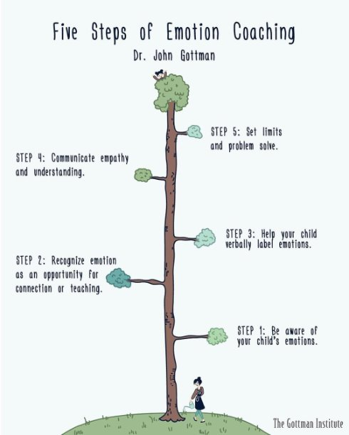
How to Say “No” Effectively
Stay calm and firm
Use a clear, simple explanation
Keep it brief
Show empathy
Example:
“I know you really want more screen time, but it’s time to stop now.”

Slide 14
The Power of Empathy
Acknowledge feelings without changing the boundary
Helps children feel understood
Examples:
“I can see you’re upset.”
“That’s disappointing, isn’t it?”
You can be kind AND firm at the same time

Slide 15
Positive Reinforcement
Notice and praise good behaviour
Effective statements
Be specific:
“Great job stopping when I asked you.”
“I love how you listened straight away.”
Children repeat what gets attention

Slide 16
Setting Realistic Boundaries
Keep expectations age-appropriate (elasticated boundary)
Don’t overwhelm with too many rules
Focus on what really matters
Top priorities:
Safety
Respect
Kind behaviour

Slide 17
Remember
Saying “no” = teaching life skills
Children need both love and limits
You are helping them grow into confident, capable adults
Children feel safest when adults are in charge with kindness and consistency.

Slide 18
Preparing for Primary: Your feelings
It's understandable that you might have mixed emotions about your child starting school, including:
Pride – seeing your child meet an important milestone.
Excitement – for new experiences, friendships and learning opportunities.
Relief – especially is managing childcare has been challenging.
Uncertainty – adjusting to a new phase of family life
Anxiety or worry – wondering how they will settle in and cope with new routines or triggering memories of your own school experience.
Try not to let your worries become your children's worry.

Slide 19
Preparing for Primary: Changes
When your child starts school, you might notice some changes in their behaviour:
Tiredness – a good bedtime routine is recommended.
Emotional collapse – your child might come home highly emotional. Please be reassured this is normal behaviour and does not necessarily mean there is anything wrong. Your child has complied to school routines all day, so might come home and release their emotions.

Slide 20
Preparing for Primary: Manners and Boundaries
Our school rules are Ready, Safe and Respectful. Our Reception children can reflect this by saying "please" and "thank you", listen when adults are talking to them and showing kindness to their peers.
We understand that starting school comes with new rules and boundaries for your children. It may take time for them to adjust to these new expectations. The adults in class will support and guide them.

Slide 21
Preparing for Primary: Resources
School Website – there is lots of useful information and advice on our school website.
BBC Bitesize- www.cbeebies/grownups/how-to-prepare-your-child-for-primary-school
www.bbc.co.uk/cbeebies/curations/starting-school-curation
These websites have lots of information, advice, and games about starting school. The My First Day At School game is interactive.

Slide 22
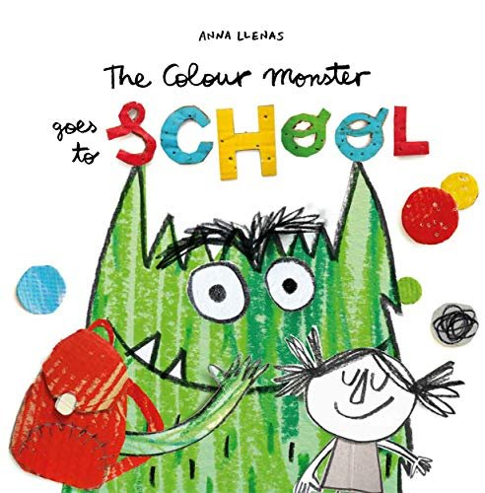
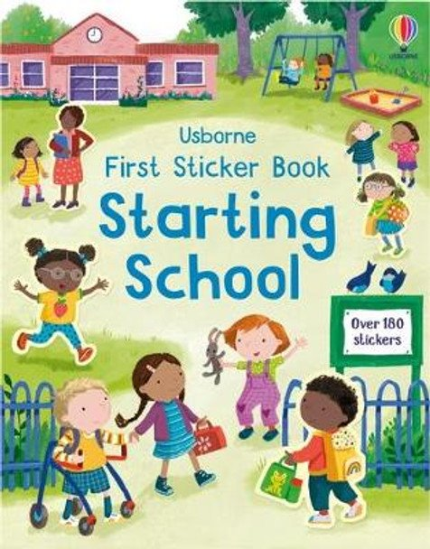
Preparing for Primary: Resources
Books:
“The Colour Monster Goes to School” by Anna Llenas
“Why Do I Have to go to School?” by K Daynes & M Alvarez Miguens.
“Starting School Sticker Book” by Usborne
Tapestry App – Reception Teachers use this App to share information with parents and post photographs.

